Slide 1



Bus Ticket Booking System
My Project (CSE 1112)
Presented By:- Bijoy Das gupta
Id: 0112330355 , Sec:- f , Cse Dept.

Slide 2
Project Overview
I have created my project using C programming language. This Project is here to assist passengers for not only booking a ticket but also edit it. They can print out that ticket later
Welcome Section
Register And Login
Book A Ticket
View Reservation
Edit Reservation
Print Out The ticket
Log Out And Exit

Slide 3
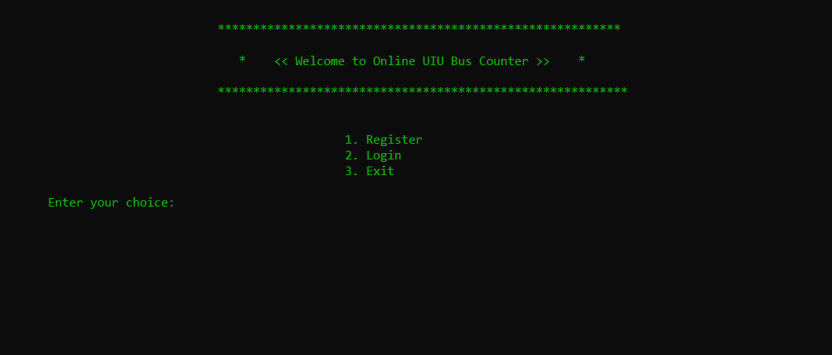
Welcome To The Main Interface

Slide 4
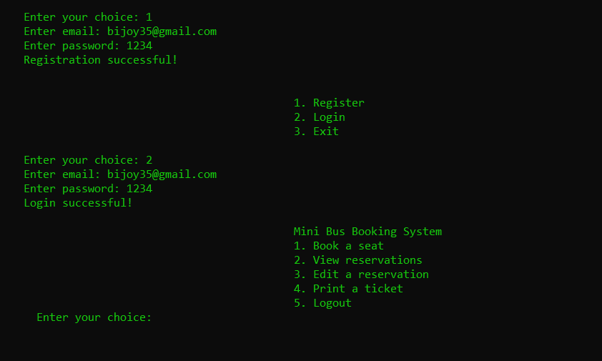
Register To save the email, password and login To open the project

Slide 5
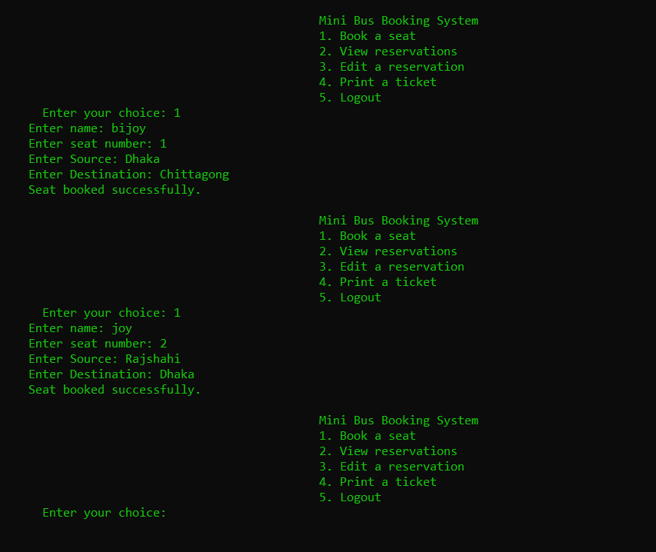
Booking A Ticket

Slide 6
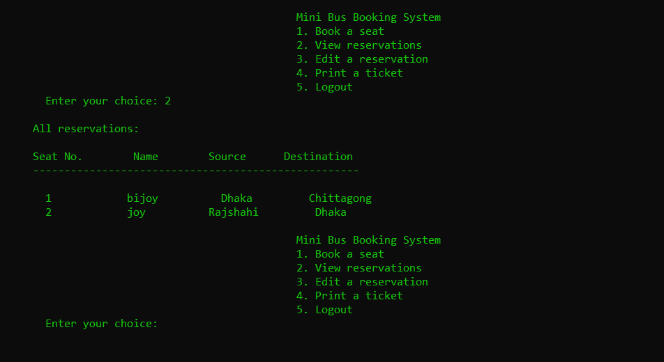
Viewing Reservation

Slide 7
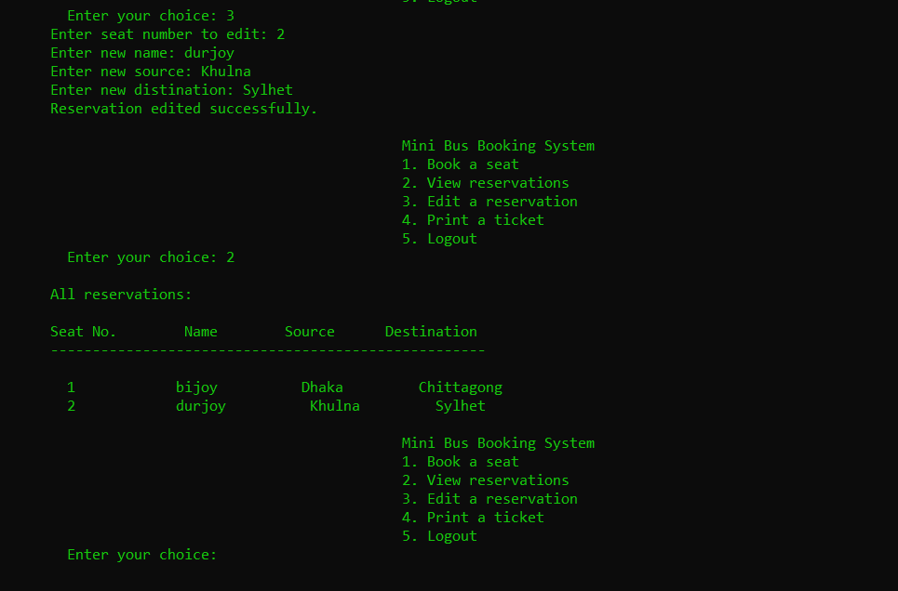
Editing Reservation

Slide 8
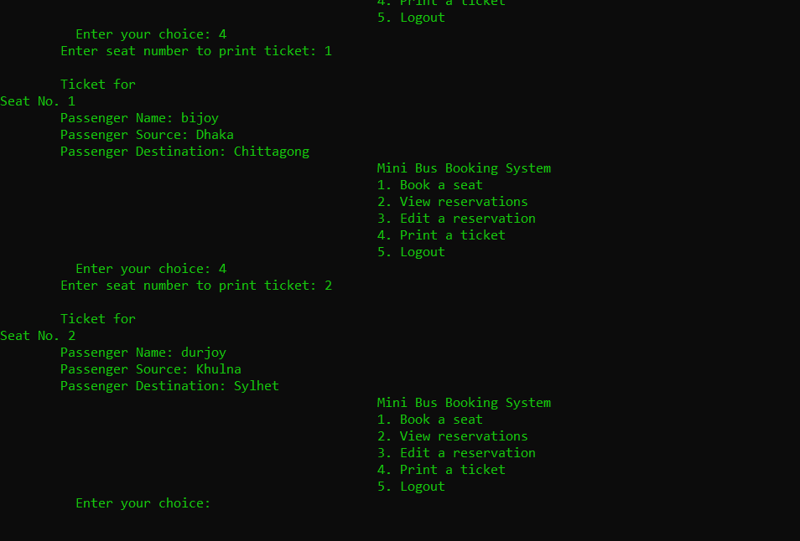
Printing Out The Ticket

Slide 9
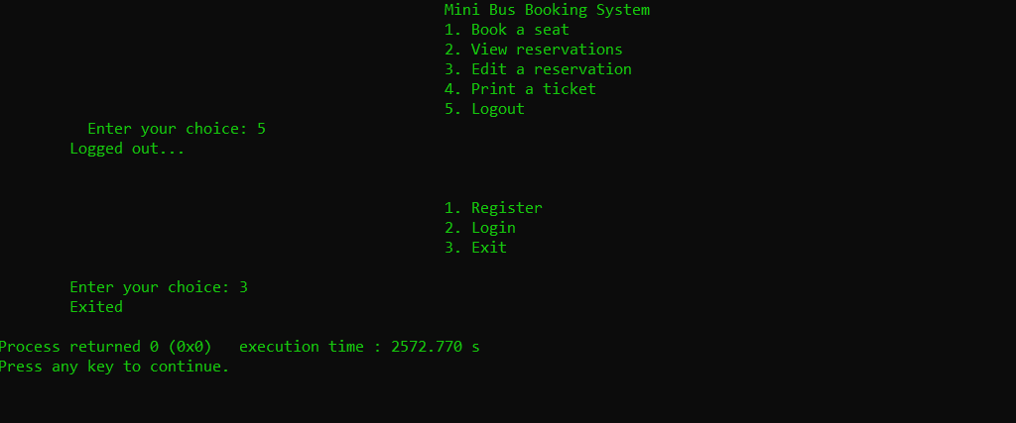
Logging Out From The Project And Exiting From The Program

Slide 10
Thank you !!!

